Slide 1
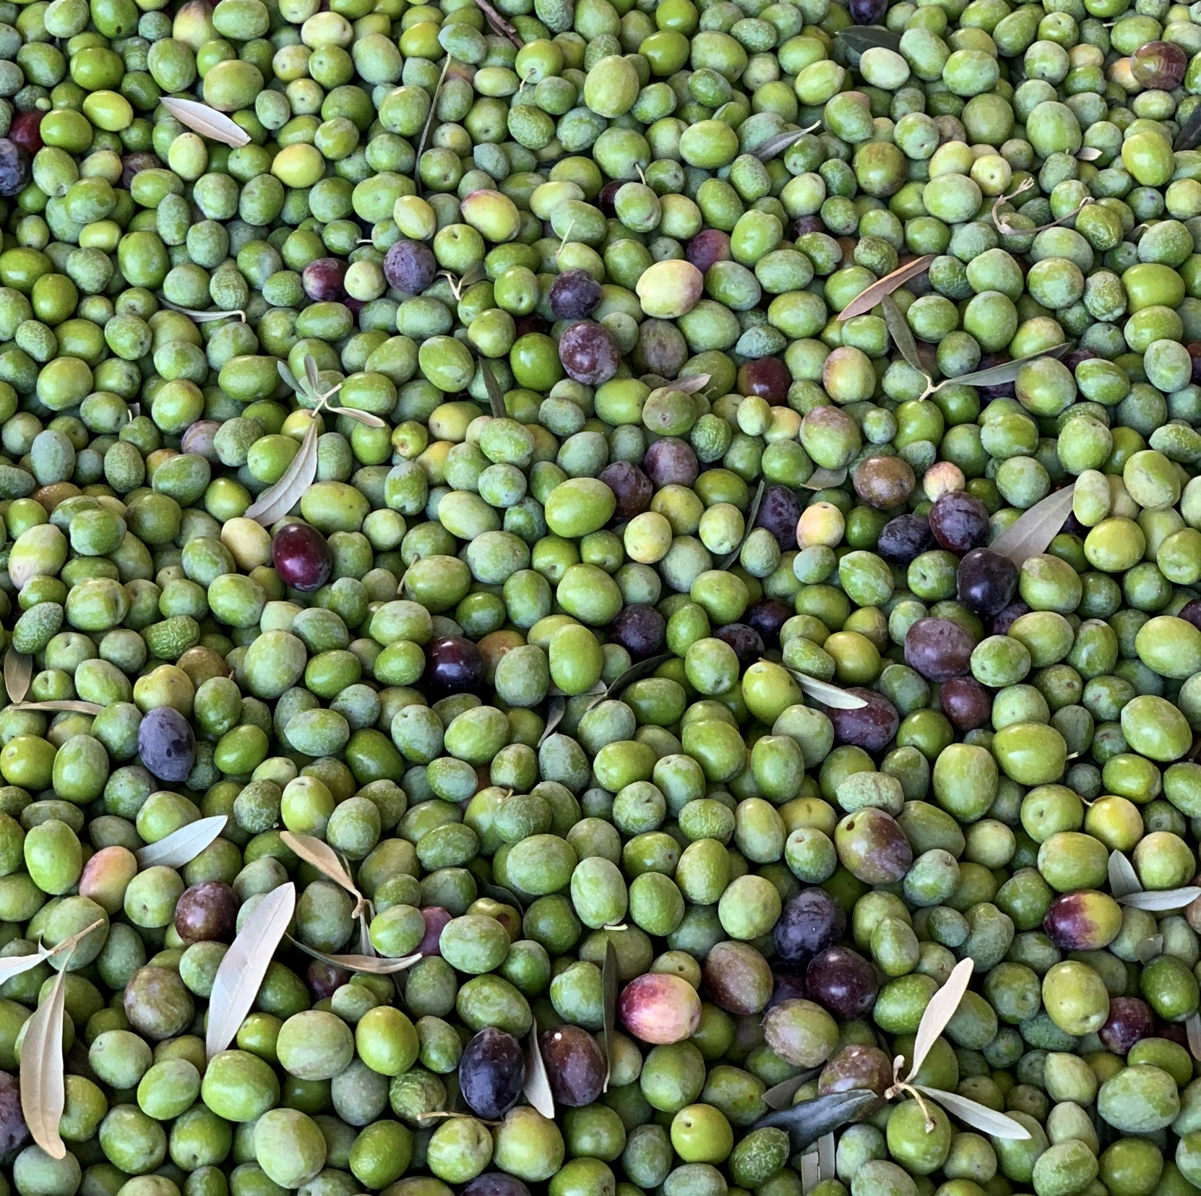
Exciting News
Bondolio oil is certified organic
grower and mill!
We believe in being good stewards of the earth and have always practiced Old World farming methods that
are gentle on the land.
Now it’s official.
Winters, California
Bondolio.com | 916.715.9007

